Slide 1
Template _ How to vote

Slide 2
Practical voting guide to be used as an example/model presentation for the voters.

Slide 3
Voting from PC

Slide 4
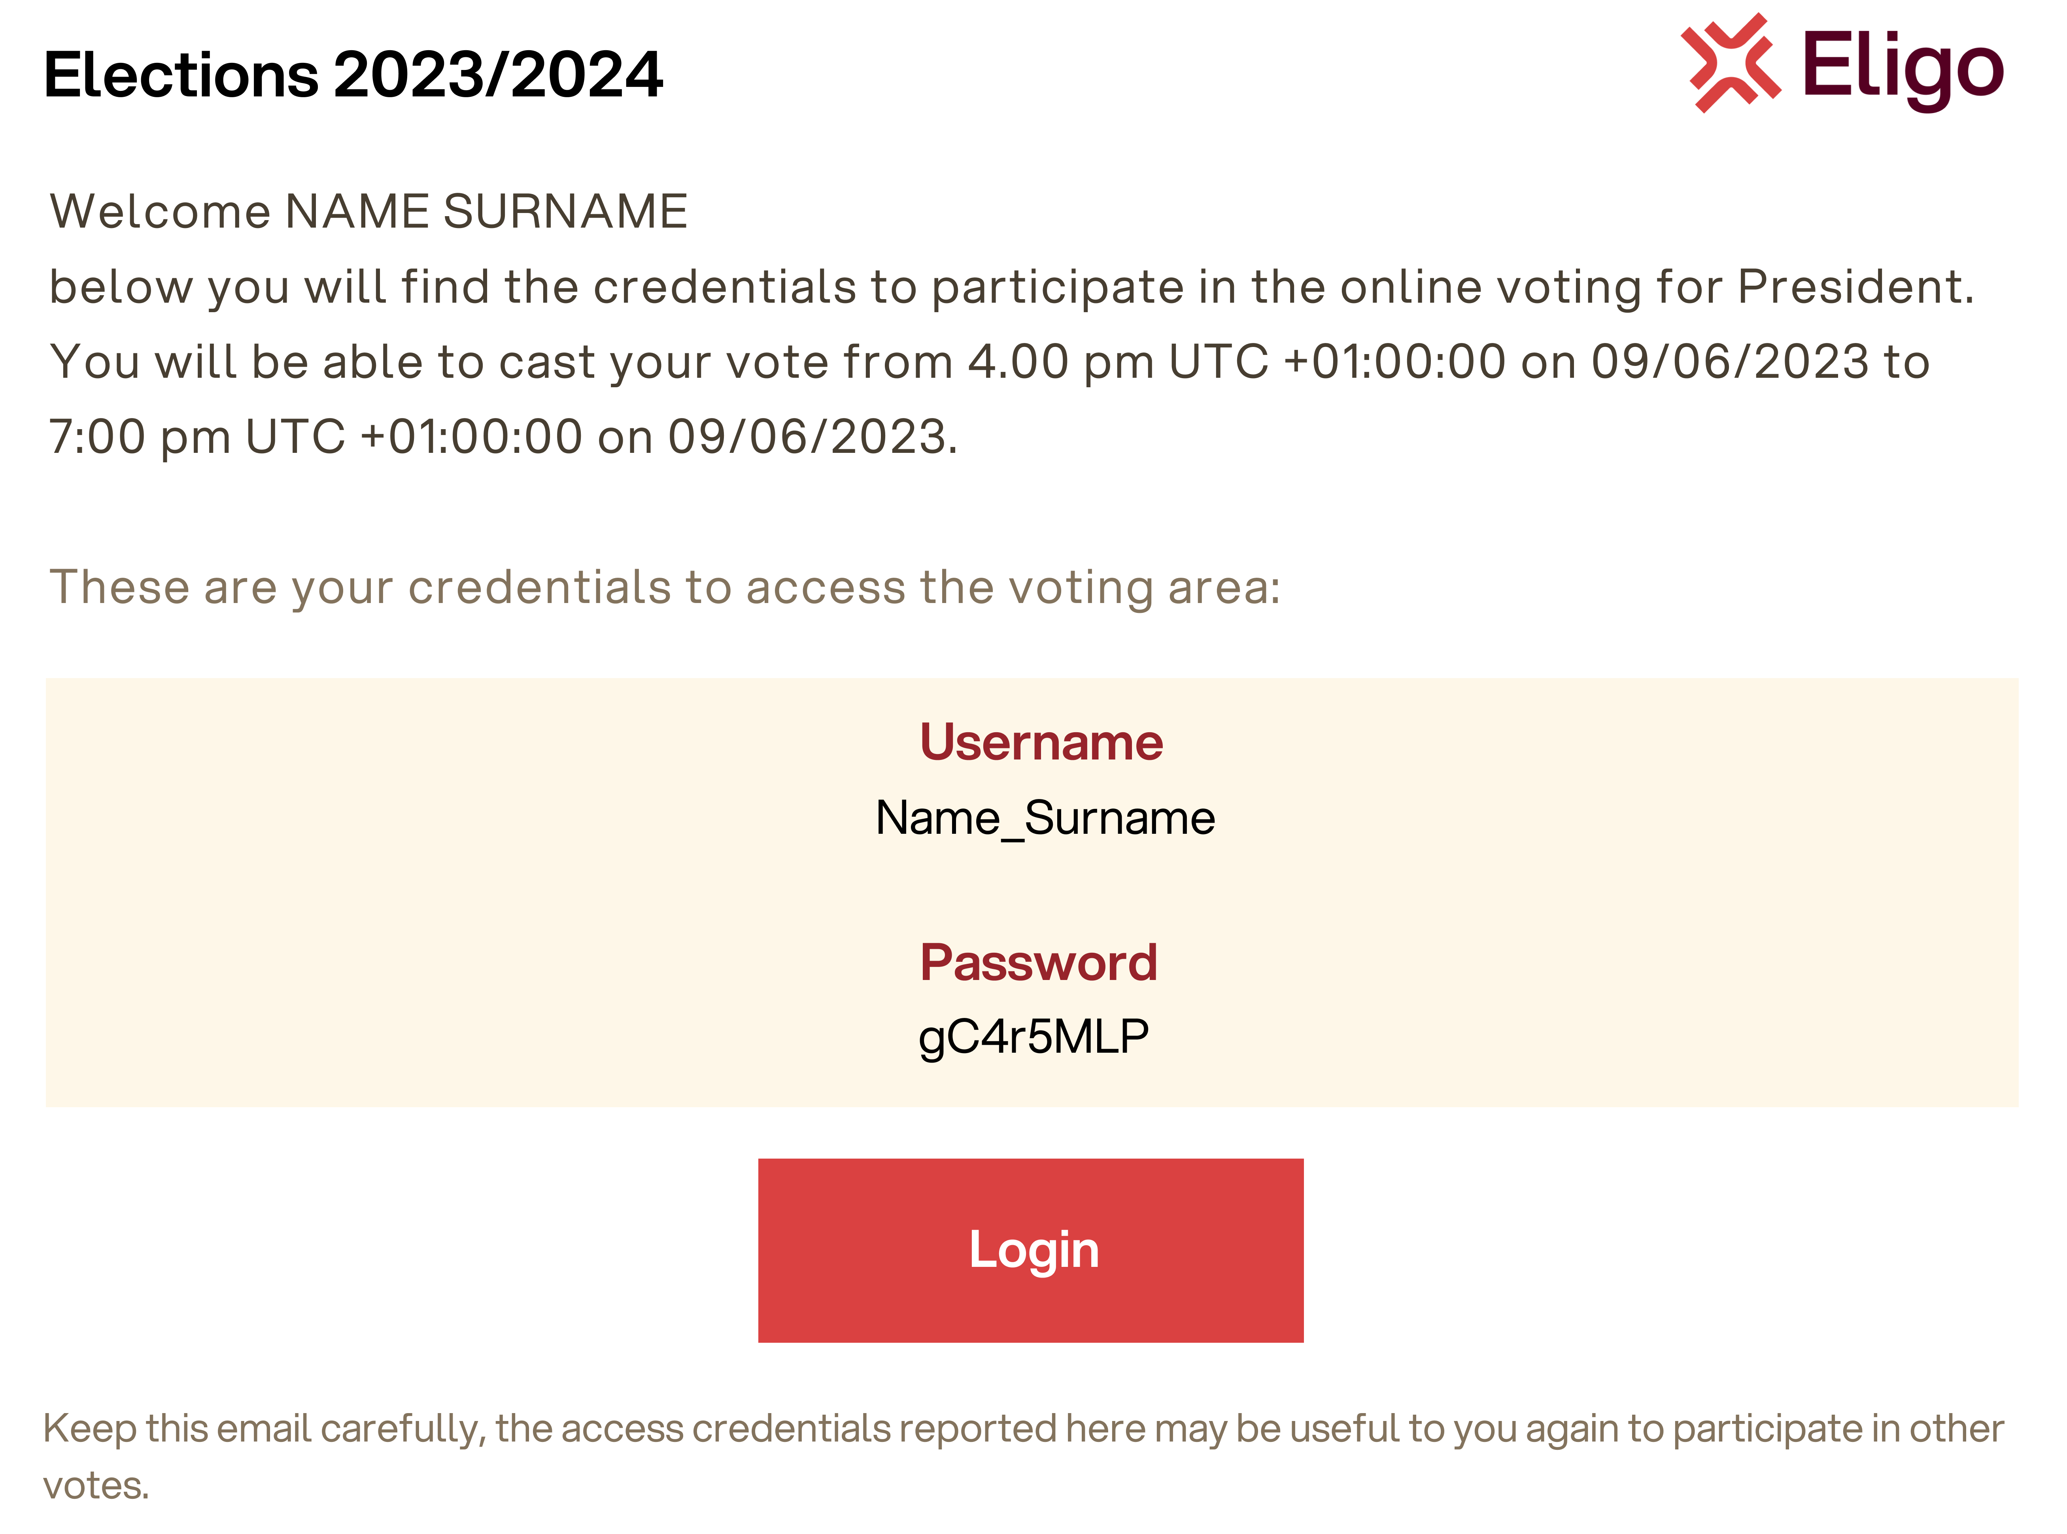
Voting from pc
Email with login details.
A few days before the vote, you will receive by email your login credentials (username and password) and the link to log in to the voting area (Login to Vote button). You will be able to log in only when voting is open, at the times indicated in the email
Subject: Eligo Evoting Credentials of FirstName_LastName- Votation title Sender: notifica@evoting.it

Slide 5
Voting from pc
Access the voting area.
Enter username and password received in the form at the top left. If entering login credentials with "copy/paste," be careful to copy only characters without the space before and/or after.

Slide 6
VOTING FROM PC
Express your vote.
The ballot(s) to be voted on will be displayed.
To cast your vote, select the button for the chosen candidate to assign preference(s).
Re-press to deselect the candidate and select another candidate. Click on "Confirm Preferences“.

Slide 7
Voting from pc
Confirm your vote.
Once the ballot is assigned, the ballot summary page is presented, like the example screenshot at the side.
The ballot is entered into the digital ballot box, only after this step.
By pressing on “Confirm vote," the vote becomes unchangeable.

Slide 8
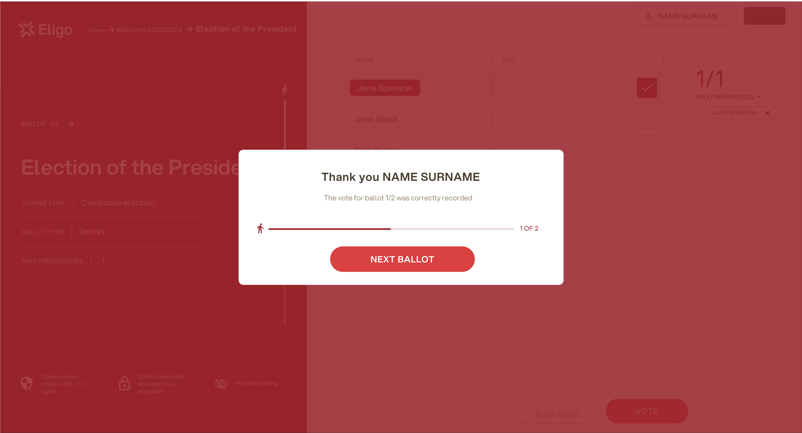
VOTING FROM PC
Vote done.
Once the vote is confirmed, a message will appear that the vote has been recorded.
DO NOT close the browser or turn off the PC.
Click "Continue" to end the voting operations or move to the next ballot.

Slide 9
Voting from smartphone

Slide 10
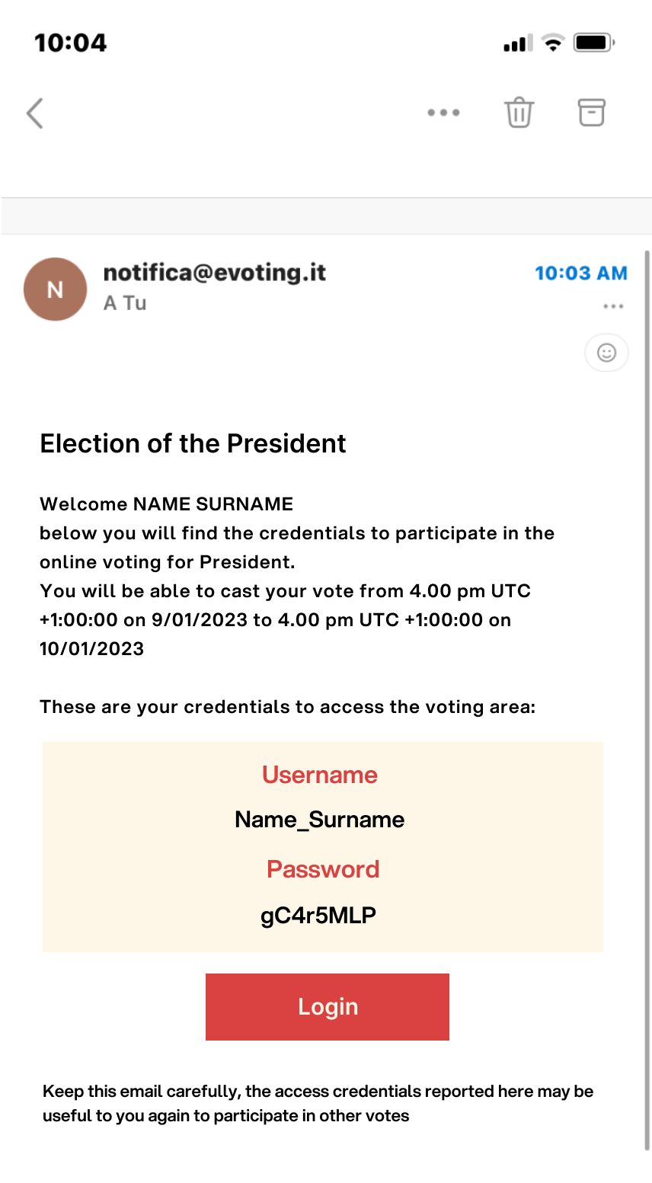
Voting from smartphone
Email with login details.
A few days before the vote, you will receive by email your login credentials (username and password) and the link to log in to the voting area (Login to Vote button). You will be able to log in only when voting is open, at the times indicated in the email
Subject: Eligo Evoting Credentials of FirstName_LastName- Votation title Sender: notifica@evoting.it

Slide 11
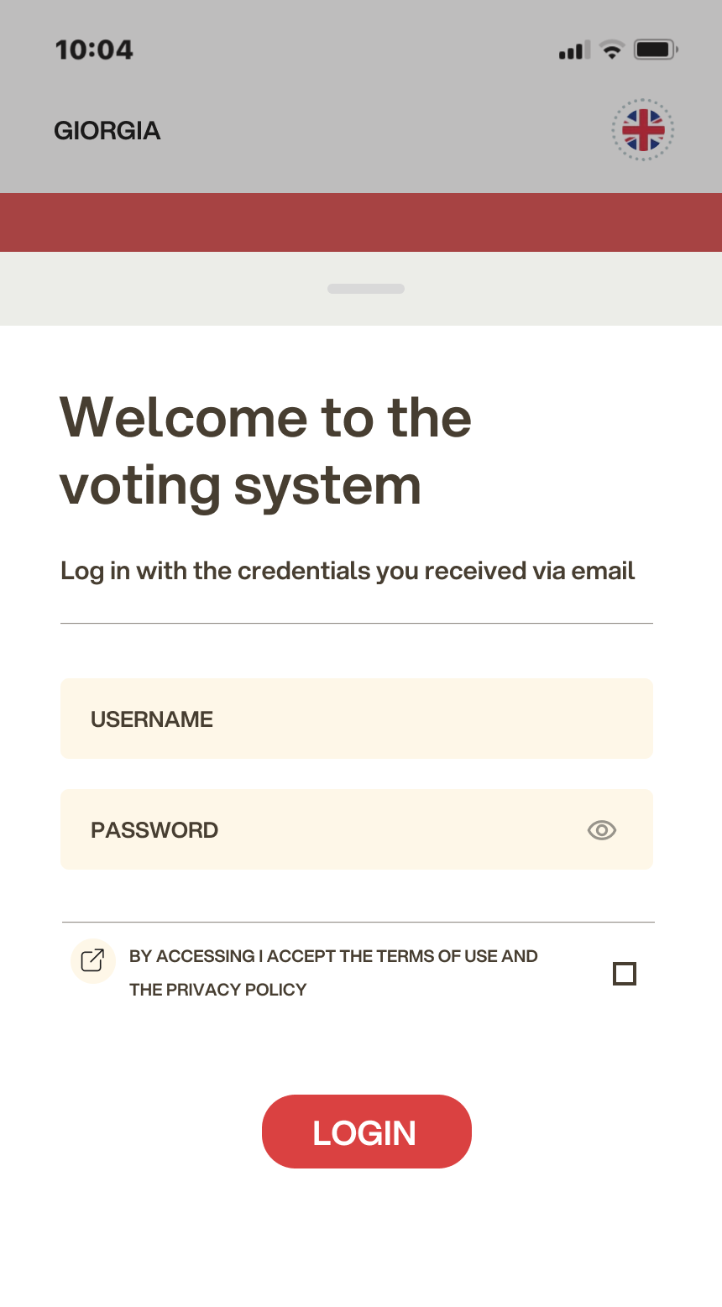
Voting from smartphone
Access the voting area.
Enter username and password received in the email.
If entering login credentials with "copy/paste," be careful to copy only characters without the space before and/or after.

Slide 12
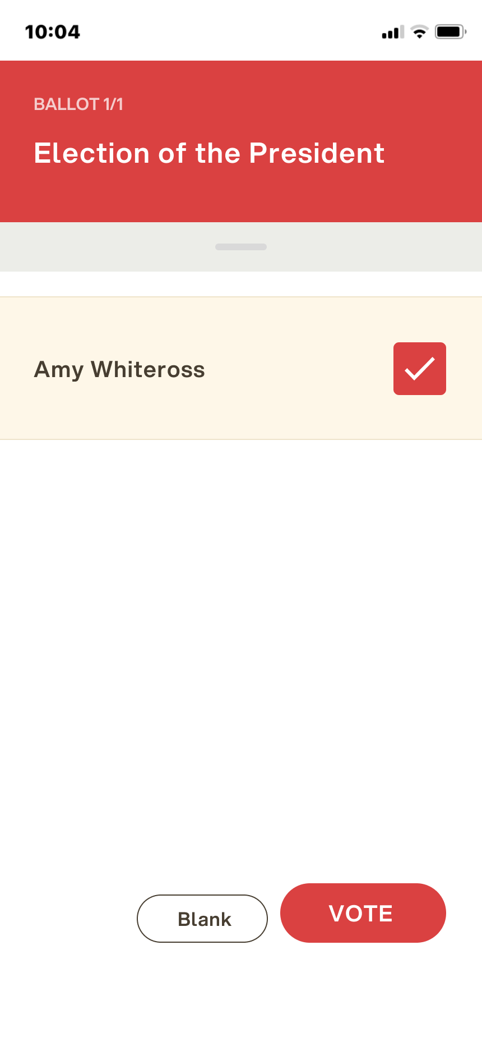
Voting from smartphone
Express your vote.
The ballot(s) to be voted on will be displayed.
To cast your vote, select the button for the chosen candidate to assign preference(s).
Re-press to deselect the candidate and select another candidate. Click on "Confirm Preferences“.

Slide 13
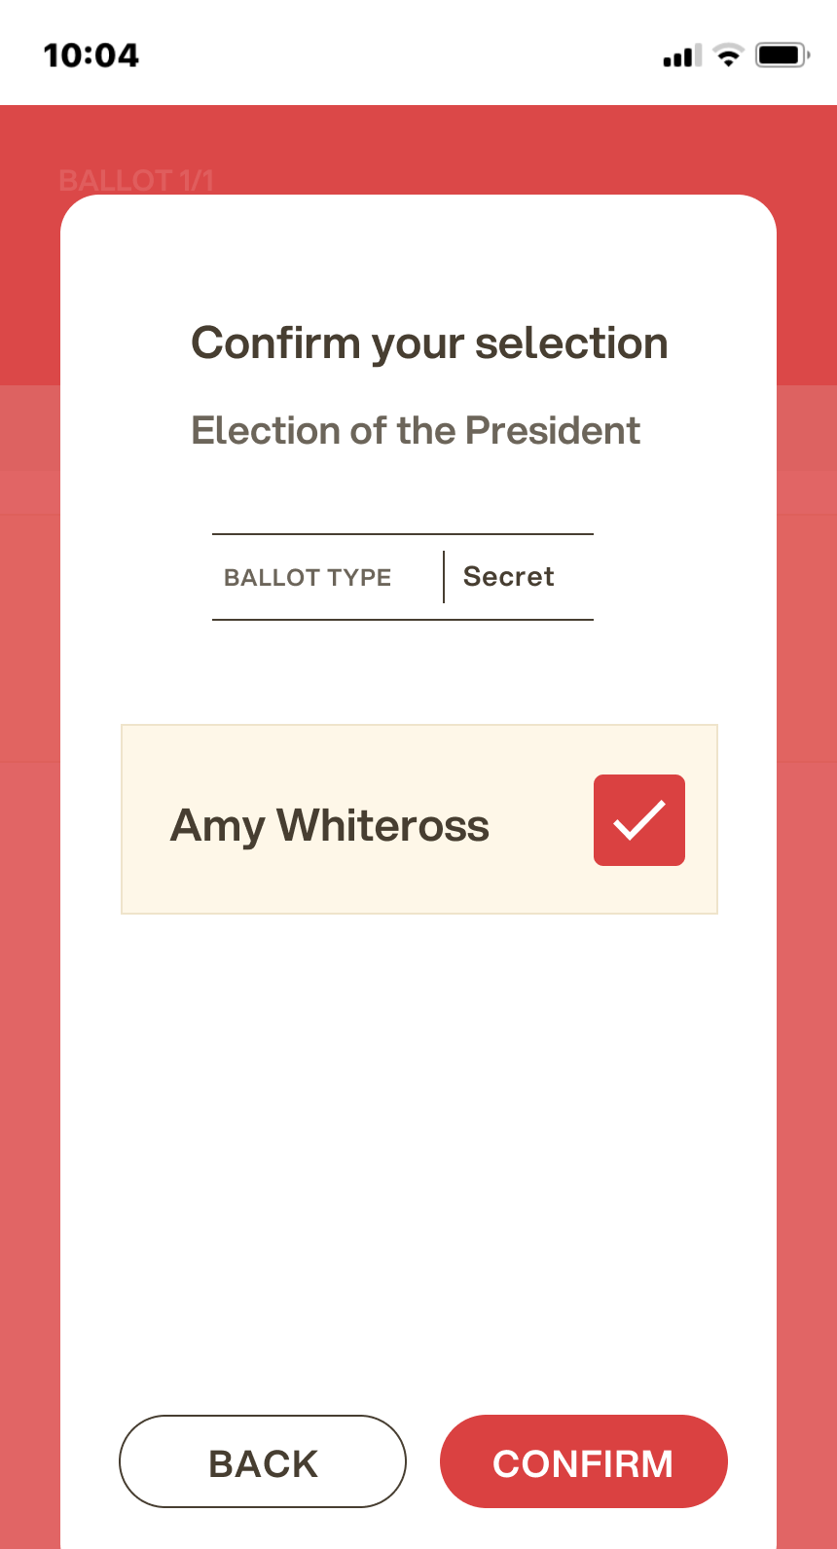
Voting from smartphone
Confirm your vote.
Once the ballot is assigned, the ballot summary page is presented, like the example screenshot at the side.
The ballot is entered into the digital ballot box, only after this step.
By pressing on “Confirm vote," the vote becomes unchangeable.

Slide 14
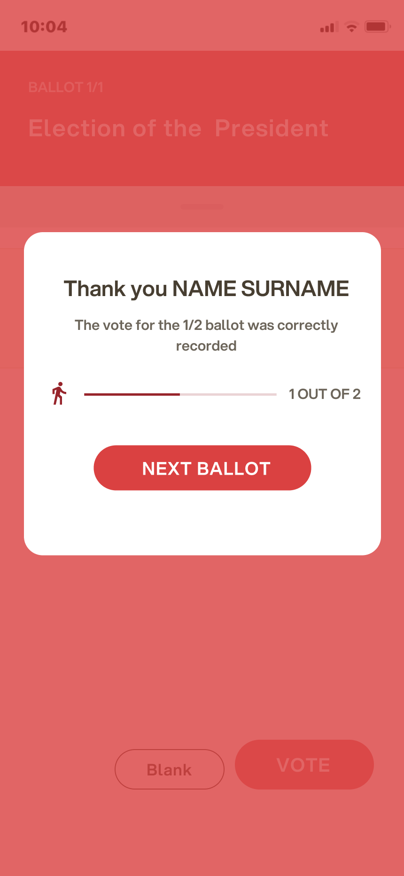
Voting from smartphone
Vote done.
Once the vote is confirmed, a message will appear that the vote has been recorded.
DO NOT close the browser or turn off the smartphone.
Click "Continue" to end the voting operation or move to the next ballot.

Slide 15
Strong Authentication access

Slide 16
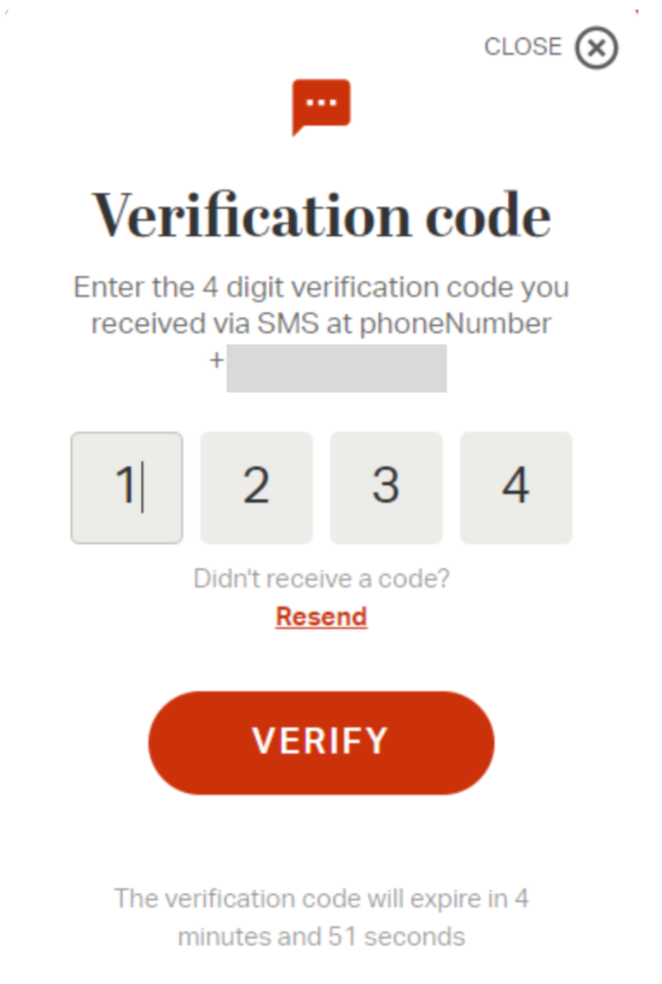
What changes for those who have requested this additional MODULE?
Dual authentication
Dual authentication access is used to increase security. After credentials are entered, an OTP (One time Password) sent via SMS is required.
If by chance you do not receive the code check the number is correct or contact the organizer immediately.
With the exception of accessing the voting area with the one time password in addition to the username and password, the procedure for the voter remains the same as described above. It is therefore possible to integrate this slide with the previous ones

Slide 17
Viale Monte Nero 17, Milano +02 80511 31 support@eligovote.com
Copyright © 2024 ELIGO | ID Technology S.r.l. P.IVA: 11240660156

